Slide 1
Approaches to Scoring Clinical Patient Notes AI Lab: Team Pyjamas
By : Leonard Paál, Yi-Hsuan Hung, Lejana Dietrich

Slide 2
Agenda
Introduction / Motivation
Problem Statement
Goal
Data
Related work
BERT
Deberta
Approach
LSTM
BERT & Deberta
Evaluation
Conclusion

Slide 3

1. Introduction / Motivation
Speaker: Leonard Paál

Slide 4

Introduction
1
Overview
Kaggle challenge: “NBME - Score Clinical Patient Notes”
We present different models to find descriptions in pieces of text.
Our solutions use:
LSTM
Transformer
BERT-based
DeBERTa-based
Speaker: Leonard Paál

Slide 5
Introduction
1
Motivation
Setting: Medical school
Medical students take exam:
The student listens to a “Standardized patient”.
They write “patient notes”. These should contain all the important features.
The patient notes are scored on whether they can capture all the relevant parts from a patient’s statements.
Scoring is done by a human committee. Costly!
Question: Could the scoring process be automated (or aided) by AI?
Speaker: Leonard Paál

Slide 6
2. Problem Statement
Speaker: Leonard / Yi-Hsuan (Shannon)

Slide 7
Problem Statement
2
Goal
Given a patient note…
”17 yo male with recurrent palpitations for the past 3 mo lasting about 3 - 4 min, it happened about 5 - 6 times since the beginning. One time durign a baskeball game two days ago light headedness, pressure in the chest, catching breath, but no fainting. During teh episodes no sweating. No diarrhea, no heat intolerance, no weight loss. Has tried aterol to be able to better concentrate, has received it from his roommate. ."
Speaker: Leonard Paál

Slide 8

Problem Statement
2
Goal
Given a patient note…
”17 yo male with recurrent palpitations for the past 3 mo lasting about 3 - 4 min, it happened about 5 - 6 times since the beginning. One time durign a baskeball game two days ago light headedness, pressure in the chest, catching breath, but no fainting. During teh episodes no sweating. No diarrhea, no heat intolerance, no weight loss. Has tried aterol to be able to better concentrate, has received it from his roommate. ."
And a feature …
“Shortness-of-breath”
Speaker: Leonard Paál

Slide 9
Problem Statement
2
Goal
Given a patient note…
”17 yo male with recurrent palpitations for the past 3 mo lasting about 3 - 4 min, it happened about 5 - 6 times since the beginning. One time durign a baskeball game two days ago light headedness, pressure in the chest, catching breath, but no fainting. During teh episodes no sweating. No diarrhea, no heat intolerance, no weight loss. Has tried aterol to be able to better concentrate, has received it from his roommate. ."
Determine
character range!
[(114, 129)]
And a feature …
“Shortness-of-breath”
Speaker: Leonard Paál

Slide 10

Problem Statement
2
Data - Structure
Train:14300; Test: 5
42146 notes
143 features
Test.csv
Train.csv
patient_notes.csv
features.csv
Training and Testing
Dataset
Detail information during encounters
(during exam and interview)
Rubric of features
Speaker: Yi-Hsuan Hung

Slide 11
Problem Statement
2
Data - Structure
Feature_text | Annotation | location | pn_num | pn_history
Lightheaded | ['felt as if he were going to pass out'] | ['222 258'] | 00016 | HPI: 17yo M presents …but this time had chest pressure and felt as if he were going to pass out (did not lose conciousness). … headache, fatigue, changes in sleep,
Lightheaded | ['light headedness'] | ['552 568'] | 00046 | Mr. Cleveland is a 17yo M who was consented by parents to be alone today and provide information. …ROS is negative except for light headedness and SOB.
heart-pounding-OR-heart-racing | ['palpitations', 'heart beating/pounding'] | ['26 38', '96 118'] | 00016 | HPI: 17yo M presents with palpitations…palpitations …Patient reports 3-4 months of intermittent episodes of ""heart beating/pounding out of my chest.""
… | … | … | … | …
Speaker: Yi-Hsuan Hung
Notes:
We merge all of files, and these columns are we need when training the model.
For example, doctor will based on the pn_history, to find out some annotations.
And these annotations are the feature_text to know what problem the patients have.
Location is the index range of annotation in pn_history.
Pn_num I show to you is because one pn_history may have multiple features.

Slide 12
Problem Statement
Annotation | location | pn_history
['ather heart attack'] | ['222 258'] | FHx - mother thyroid disease, father heart attack at the age of 52, …
… | … | …
Need to update both location and annotation
-1
2
Data - Structure
Predict
Input
Feature_text | Annotation | location | pn_num | pn_history
Lightheaded | ['felt as if he were going to pass out'] | ['222 258'] | 00016 | HPI: 17yo M presents …but this time had chest pressure and felt as if he were going to pass out (did not lose conciousness). … headache, fatigue, changes in sleep,
Lightheaded | ['light headedness'] | ['552 568'] | 00046 | Mr. Cleveland is a 17yo M who was consented by parents to be alone today and provide information. …ROS is negative except for light headedness and SOB.
heart-pounding-OR-heart-racing | ['palpitations', 'heart beating/pounding'] | ['26 38', '96 118'] | 00016 | HPI: 17yo M presents with palpitations…palpitations …Patient reports 3-4 months of intermittent episodes of ""heart beating/pounding out of my chest.""
… | … | … | … | …
Speaker: Yi-Hsuan Hung
Notes:
We will feed the pn_history and the feature_text into our model.
And let the model predict what kinds of annotations have, and its location in pn_history.

Slide 13
Problem Statement
2
Data – Typo data
Need to update both location and annotation
Annotation | location | pn_history
['ather heart attack'] | ['222 258'] | FHx - mother thyroid disease, father heart attack at the age of 52, …
… | … | …
patient_notes.csv
-1
Speaker: Yi-Hsuan Hung
Feature_text | Annotation | location | pn_num | pn_history
Lightheaded | ['felt as if he were going to pass out'] | ['222 258'] | 00016 | HPI: 17yo M presents …but this time had chest pressure and felt as if he were going to pass out (did not lose conciousness). … headache, fatigue, changes in sleep,
Lightheaded | ['light headedness'] | ['552 568'] | 00046 | Mr. Cleveland is a 17yo M who was consented by parents to be alone today and provide information. …ROS is negative except for light headedness and SOB.
heart-pounding-OR-heart-racing | ['palpitations', 'heart beating/pounding'] | ['26 38', '96 118'] | 00016 | HPI: 17yo M presents with palpitations…palpitations …Patient reports 3-4 months of intermittent episodes of ""heart beating/pounding out of my chest.""
… | … | … | … | …
Notes:
However, we also find some wrong annotation. For example, in this case, the annotation should be father heart attack, rather than ather heart attack

Slide 14
Problem Statement
2
Data – Typo data
Need to update both location and annotation
Annotation | location | pn_history
[‘father heart attack'] | [‘221 258'] | FHx - mother thyroid disease, father heart attack at the age of 52, …
… | … | …
-1
patient_notes.csv
We corrected a total of 42 instances of annotation errors in the dataset
Speaker: Yi-Hsuan Hung
Notes:
So we corrected a total of 42 row data which have wrong annotation, and also need to update its location in pn_history.

Slide 15

3. Related Work
Speaker: Lejana Dietrich / Yi-Hsuan (Shannon)

Slide 16
Related Work
3
Transformer model for all non-generative NLP tasks (no decoder stack)
Trained for deeply bi-directional context recognition
BERT
Add & Norm
…
24
Encoder
Feed Forward
Encoder
…
12
Encoder
…
4
Encoder
Add & Norm
3
Encoder
3
Encoder
4
Encoder
4
Encoder
Multi-Head Attention
1
Encoder
1
Encoder
BERT Base
BERT Large
Speaker: Lejana Dietrich

Slide 17
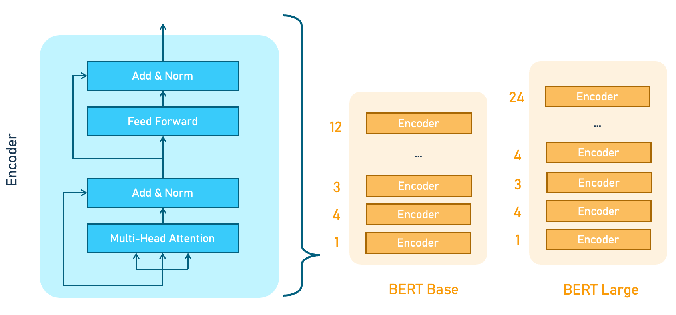
Related Work
3
Transformer model for all non-generative NLP tasks (no decoder stack)
Trained for deeply bi-directional context recognition
BERT
Speaker: Lejana Dietrich

Slide 18
Related Work
3
Transformer model for all non-generative NLP tasks (no decoder stack)
Trained for deeply bi-directional context recognition
BERT
We use the BERT base-uncased model with 12 nested layers
Speaker: Lejana Dietrich

Slide 19
Related Work
3
DeBERTa
Developed by Microsoft in 2020 and derived from BERT
The DeBERTa V3 base model comes with 12 layers and a hidden size of 768. Has 86M backbone parameters with a vocabulary containing 250K tokens which introduces 190M parameters in the Embedding layer.
Difference from BERT: Disentangled attention mechanism
While BERT adds absolute positions of tokens to their context embedding vectors, DeBERTa keeps these properties separate, creating 2 vector embeddings.
From these disentangled attention can be calculated in a more complex but also more accurate way than BERT.
Same as BERT:
Can be used for the same tasks as BERT with better performance, thought makes training more expensive
Base size consists of 12 layers
Speaker: Yi-Hsuan Hung

Slide 20
4. Approach
Speaker: Leonard / Yi-Hsuan / Lejana

Slide 21
Approach
4
LSTM – Data Preparation
Data Preparation
Patient notes and features are tokenized with BERT
Each token is given a score:
1 if part of relevant range, 0 if not
Scored tokens become training data.
[originally planned postprocessing] merge tokens of model to character ranges.
Speaker: Leonard Paál

Slide 22
Approach
4
LSTM – Model
LSTM
#1
LSTM
#2
Hidden
256 x 1
Embedded feature
Feature length x 768
768
pn_history length
x 1536
Pn_history length
x 256
Sigmoid
Concatenation
Pn_history length
Output
[pn_history length]
Embedded feature
pn_history length x 768
Speaker: Leonard Paál

Slide 23
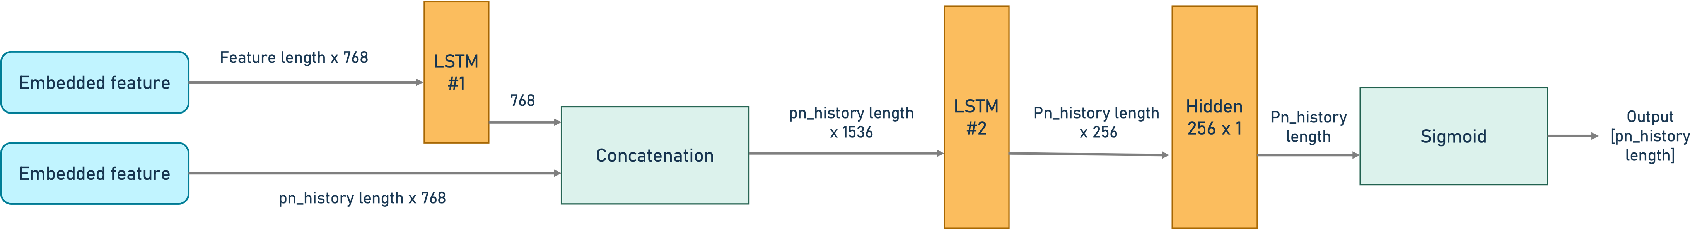
Approach
4
LSTM – Model
Speaker: Leonard Paál

Slide 24
Approach
4
LSTM – Model
Speaker: Leonard Paál

Slide 25
Approach
4
LSTM – Model
Speaker: Leonard Paál

Slide 26

Approach
Make the history token (circunstance) have relation with feature
4
BERT & DeBERTa – Data Preparaion
Lightheaded
feature_text
Index: ['552 568']
[-1,0,0,0,…,1,1,0,0,-1,-1,-1]
Where 1 is loc of annotation
pn_history
Mr. Cleveland is a 17yo M who was … negative except for light headedness and SOB.
convert
Input
Label
Speaker: Yi-Hsuan Hung
Notes:
The purpose of this mechanism is for letting model learn that the history situation and the feature_text have relation.

Slide 27
Approach
Make the history token (circunstance) have relation with feature
4
BERT & DeBERTa – Data Preparaion
Lightheaded
feature_text
Build up the relation
Index: ['552 568']
[-1,0,0,0,…,1,1,0,0,-1,-1,-1]
Where 1 is loc of annotation
pn_history
Mr. Cleveland is a 17yo M who was … negative except for light headedness and SOB.
convert
Input
Label
Speaker: Yi-Hsuan Hung
Notes:
The purpose of this mechanism is for letting model learn that the history situation and the feature_text have relation.

Slide 28

Approach
Make the history token (circunstance) have relation with feature
4
BERT & DeBERTa – Data Preparaion
Lightheaded
Training & Learning
feature_text
Build up the relation
Index: ['552 568']
[-1,0,0,0,…,1,1,0,0,-1,-1,-1]
Where 1 is loc of annotation
pn_history
Mr. Cleveland is a 17yo M who was … negative except for light headedness and SOB.
convert
Input
Label
Speaker: Yi-Hsuan Hung
Notes:
The purpose of this mechanism is for letting model learn that the history situation and the feature_text have relation.

Slide 29
Approach
4
BERT & DeBERTa – Data Preparaion
Whole step of preparing dataset (input, label)
Find the max_len input size
Convert the inputs, including pn_history + feature_text,to tokens
Convert the pn_history into the labels with value {-1,0,1}
Prepare max_len array with 0
Filled special token ([CLS], [SEP], [PAD], etc) with -1
Find the tokens which contain the annotations, and filled with value with 1
Result will be like: [-1, 0, 0, 1, 1, 0, 0]
Speaker: Yi-Hsuan Hung
Notes:
BERT, and other Transformer-based models, necessitate a fixed maximum sequence length during input processing due to the self-attention mechanism

Slide 30
Approach
4
BERT & DeBERTa – Data Preparaion
Add len(token_ids) to array.
token_ids
[1,100,33,…,4]
Tokenize
arr[len(…),len(…),…]
pn_history
+
feature_text
Combine feature_text and pn_history
Each row
Speaker: Yi-Hsuan Hung

Slide 31
Approach
4
BERT & DeBERTa – Data Preparaion
Add len(token_ids) to array.
token_ids
[1,100,33,…,4]
Tokenize
Finally we peak the max_len of token_ids as our model input size
arr[len(…),len(…),…]
Pretend our max_len is 15.
pn_history
+
feature_text
Combine feature_text and pn_history
Each row
Iterate till the end
Speaker: Yi-Hsuan Hung

Slide 32
Approach
4
Special token
Token
BERT & DeBERTa – Data Preparaion (Input)
Pretend our max_len is 15.
Input_ids:
[1, 100, 33, 10, 19344, 4, 2, 104, 1758, 2, 0, 0, 0, 0, 0]
I have a headache.
Sick
headache
Tokenize
With max_len 15
pn_history
+
feature_text
annotation
Decode:
'[CLS]I have a headache.[SEP]
Sick[SEP][PAD][PAD][PAD][PAD][PAD]'
Combine feature_text and pn_history
Each row
Speaker: Yi-Hsuan Hung

Slide 33
Approach
4
Special token
Token
BERT & DeBERTa – Data Preparaion (Label)
*Label only need pn_history and annotation
headache
Input_ids:
[1, 100, 33, 10, 19344, 4, 2, 0, 0, 0, 0, 0, 0, 0, 0]
annotation
I have a headache.
Tokenize
With max_len 15
Decode:
'[CLS]I have a headache.[SEP]
[PAD][PAD][PAD][PAD][PAD][PAD][PAD][PAD]'
pn_history
Find the annotation in pn_history
Each row
Speaker: Yi-Hsuan Hung
Sick
+
feature_text

Slide 34
Approach
4
Special token
Token
BERT & DeBERTa – Data Preparaion (Label)
Input_ids:
[1, 100, 33, 10, 19344, 4, 2, 0, 0, 0, 0, 0, 0, 0, 0]
Step 1. Create the empty array with max_len
[0. 0. 0. 0. 0. 0. 0. 0. 0. 0. 0. 0. 0. 0. 0.]
Empty array: max_len:
Speaker: Yi-Hsuan Hung

Slide 35
Approach
4
Special token
Token
BERT & DeBERTa – Data Preparaion (Label)
Input_ids:
[1, 100, 33, 10, 19344, 4, 2, 0, 0, 0, 0, 0, 0, 0, 0]
Headache = [19344]
Step 2. Special Token filled with -1
annotation
[-1. 0. 0. 0. 0. 0. 0. -1. -1. -1. -1. -1. -1. -1. -1.]
Speaker: Yi-Hsuan Hung

Slide 36
Approach
4
Special token
Token
BERT & DeBERTa – Data Preparaion (Label)
Input_ids:
[1, 100, 33, 10, 19344, 4, 2, 0, 0, 0, 0, 0, 0, 0, 0]
Headache = [19344]
Step 4. Find out the position of annotation in array and filled with 1
annotation
[-1. 0. 0. 0. 0. 1. 0. -1. -1. -1. -1. -1. -1. -1. -1.]
This is our Label.
Speaker: Yi-Hsuan Hung

Slide 37
Approach
4
BERT & DeBERTa – Model & Criterion & Optimizer
BERT: bert-base-uncased
DeBERTa: microsoft/deberta-base
Custom
Extracting the last layer of hidden states
Add a single linear layer: in_features=768, out_features=1
Passing these features through the dropout layer with 0.2
Criterion: BCELossWithLogits
Optimizer: AdamW
With a weight decay of 0.1 to avoid overfitting
Rely on this optimizer for an adaptable learning rate
Speaker: Yi-Hsuan Hung

Slide 38
Approach
4
BERT & DeBERTa – Predictions
Training
Result
Input: [1, 100, 33, 10, 19344, 4, 2, 104, 1758, 2, 0, 0, 0, 0, 0]
[0.02, 0.01, 0.50, 0.07, 0.55, 0.78, 0.2, 0.01, 0.87, 0.67, 0.012, 0.1, 0.21, 0.23, 0.1 ]
Speaker: Lejana Dietrich

Slide 39
Approach
4
BERT & DeBERTa – Predictions
Training
Result
Input: [1, 100, 33, 10, 19344, 4, 2, 104, 1758, 2, 0, 0, 0, 0, 0]
[0.02, 0.01, 0.50, 0.07, 0.55, 0.78, 0.2, 0.01, 0.87, 0.67, 0.012, 0.1, 0.21, 0.23, 0.1 ]
Threshold of 0.5
[0., 0., 0., 0., 1, 1, 0., 0., 1, 1, 0., 0., 0., 0., 0. ]
Speaker: Lejana Dietrich

Slide 40
Approach
4
BERT & DeBERTa – Predictions
Training
Result
[0.02, 0.01, 0.50, 0.07, 0.55, 0.78, 0.2, 0.01, 0.87, 0.67, 0.012, 0.1, 0.21, 0.23, 0.1 ]
Input: [1, 100, 33, 10, 19344, 4, 2, 104, 1758, 2, 0, 0, 0, 0, 0]
Threshold of 0.5
[0., 0., 0., 0., 1, 1, 0., 0., 1, 1, 0., 0., 0., 0., 0. ]
[4 5; 8 9]
Grouping consecutive indices into ranges
Speaker: Lejana Dietrich

Slide 41
Approach
4
BERT & DeBERTa – Training
Training - General
80-20 training test split, batch size of 12, GTX 2070 GPU
BERT | DeBERTa
10 epochs with starting lr of 2e-6 | 5 epochs with starting lr of 2e-5
all 12+1 layers | all 12+1 layers ; last 3 layers ; last 1 layer
best of 5 folds, each using another fifth of data for testing | only 1 fold / regular train-test split
Speaker: Lejana Dietrich

Slide 42
5. Evaluation
Speaker: Leonard Paál / Lejana Dietrich
Results | Model
 | LSTM | BERT fine-tuned | DeBERTa fully fine-tuned | DeBERTa 3 layers fine-tuned
avg. loss | N/A | 0.0342 | 0.0123 | 0.0160
F1 score | 0 | 0.5454 | 0.8599 | 0.8069
best epoch / total epochs | 5/5 | 9/10 | 5/5 | 4/5
total training + test time | 2 hours (Jupyter, training only) | 1 hour (.py file ª) | 10 hours (Jupyter) | 5.5 hours (Jupyter)

Slide 43
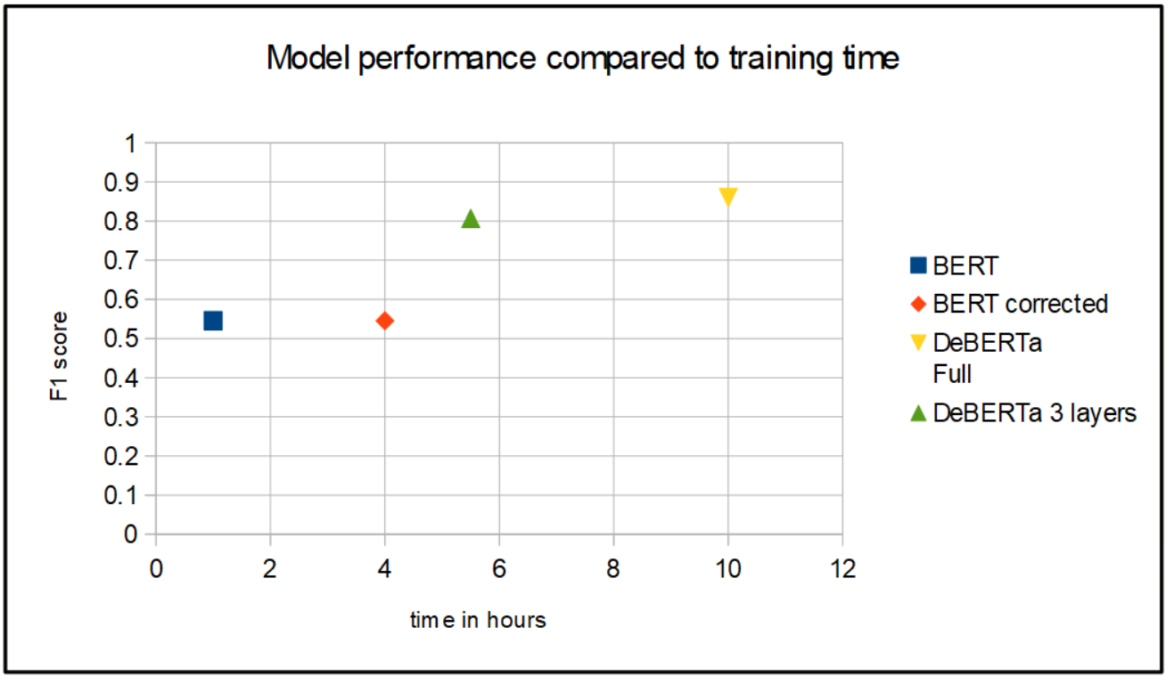
Evaluation
5
Numercial
Results | Model
 | LSTM | BERT fine-tuned | DeBERTa fully fine-tuned | DeBERTa 3 layers fine-tuned
avg. loss | N/A | 0.0342 | 0.0123 | 0.0160
F1 score | 0.107 | 0.5454 | 0.8599 | 0.8069
best epoch / total epochs | 15/20 | 9/10 | 5/5 | 4/5
total training + test time | 6 hours (Jupyter, training only) | 1 hour (.py file ª) | 10 hours (Jupyter) | 5.5 hours (Jupyter)
Speaker: Lejana Dietrich

Slide 44
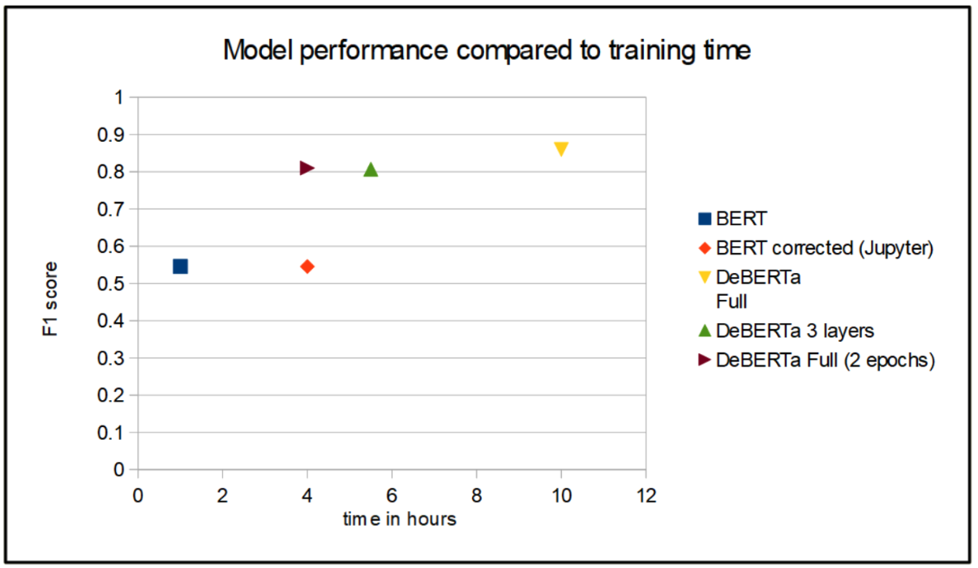
Evaluation
Results | Model
 | LSTM | BERT fine-tuned | DeBERTa fully fine-tuned | DeBERTa 3 layers fine-tuned
avg. loss | N/A | 0.0342 | 0.0123 | 0.0160
F1 score | 0 | 0.5454 | 0.8599 | 0.8069
best epoch / total epochs | 5/5 | 9/10 | 5/5 | 4/5
total training + test time | 2 hours (Jupyter, training only) | 1 hour (.py file ª) | 10 hours (Jupyter) | 5.5 hours (Jupyter)
5
Plot
Speaker: Lejana Dietrich

Slide 45
Evaluation
5
Plot
Speaker: Lejana Dietrich

Slide 46
6. Conclusion
Speaker: Lejana Dietrich

Slide 47
Conclusion
6
Overview
Problem seems too complex for LSTM (at least with the current size)
Ideal results with DeBERTa architecture
Accuracy and efficiency ideal when all layers are fine-tuned
1–2 epochs vs. 4–5 epochs to exceed score of 0.80
Ensemble models for further improvements
Approach is transferable to 16+ other languages
Speaker: Lejana Dietrich

Slide 48
Thank you

